Slide 1
Le Quy Don Primary School
English 5
Welcome to our class 5A

Slide 2
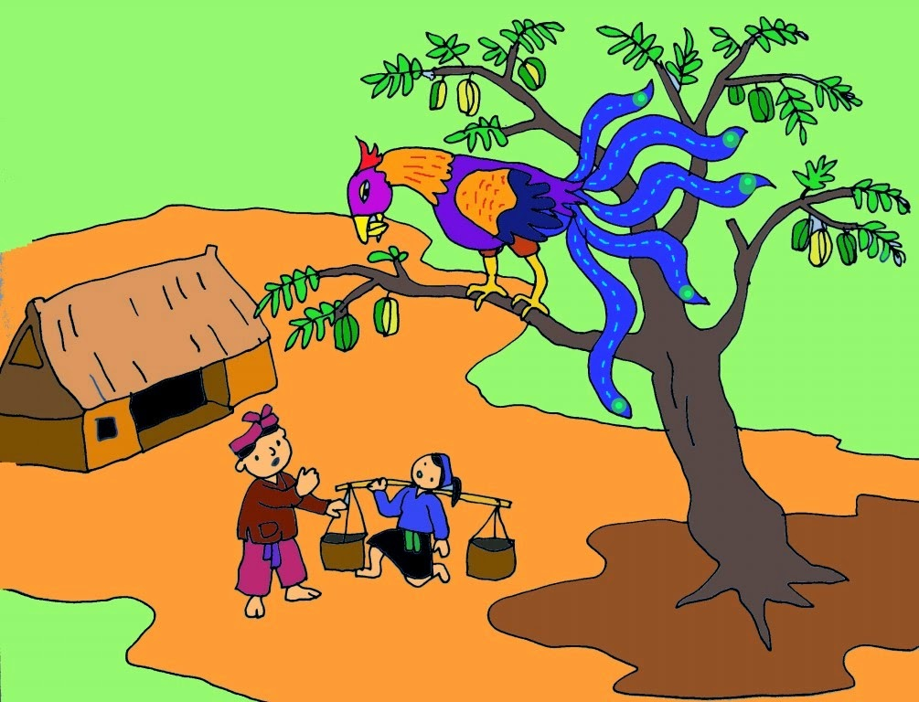
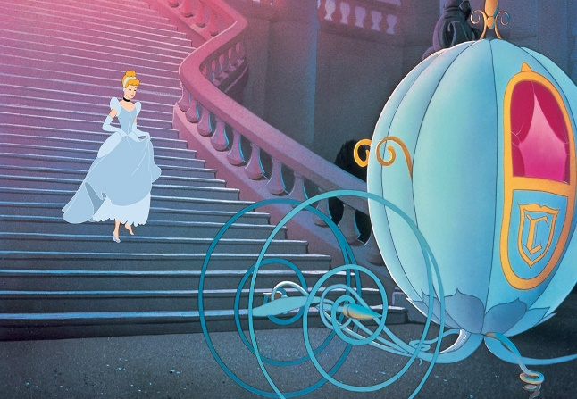
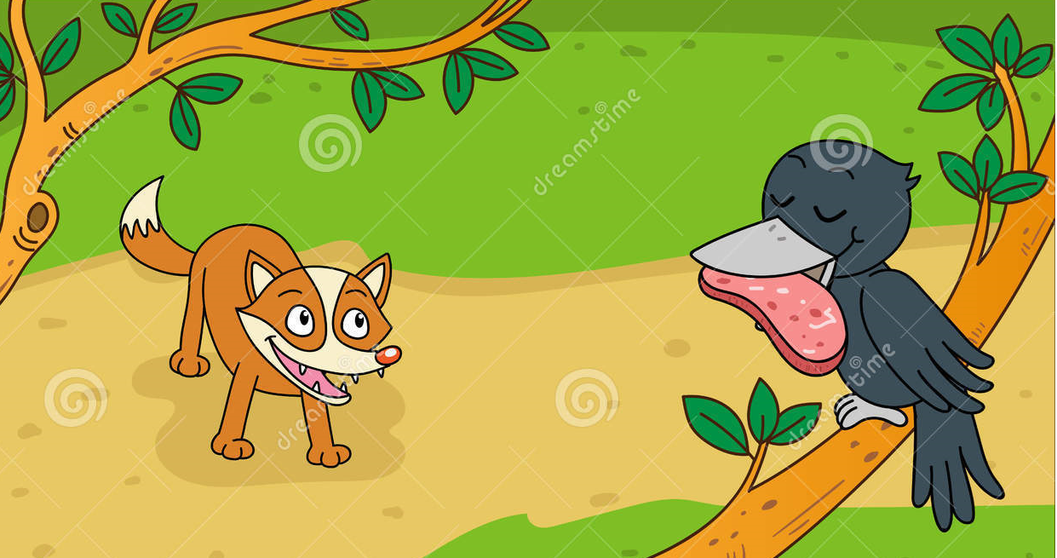
GUESSING THE MYSTERIOUS PICTURE
Câu hỏi
What is the name of this story?
Câu hỏi
What is the name of this story?
Câu hỏi
Who is the main character in the story of Tam and Cam?
1
2
3
Câu hỏi
Who is the main character in the story: Aladdin and the Magic Lamp?
Câu hỏi
Who is the main character in the story of MaiAn Tiem?
1
Câu hỏi
Who is the main character in the story: Snow White and the Seven Dwarfs?
2
3
4
4
5
6
Đáp án:
Tam
Đáp án:
An Tiem
5
Đáp án:
Aladdin
Đáp án:
Snow White
Đáp án:
The Fox and the Crow
Đáp án:
Cinderella
6
THE GOLDEN STARFRUIT TREE ( CÂY KHẾ)

Slide 3

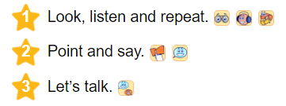
Tuesday, March 1st, 2022
Unit 14: what happened in the story?

Slide 4


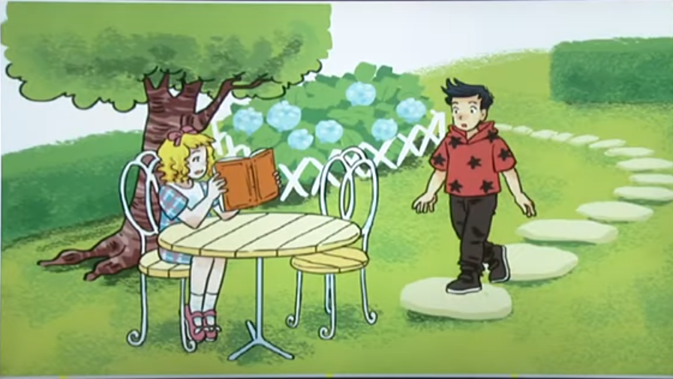

Slide 5
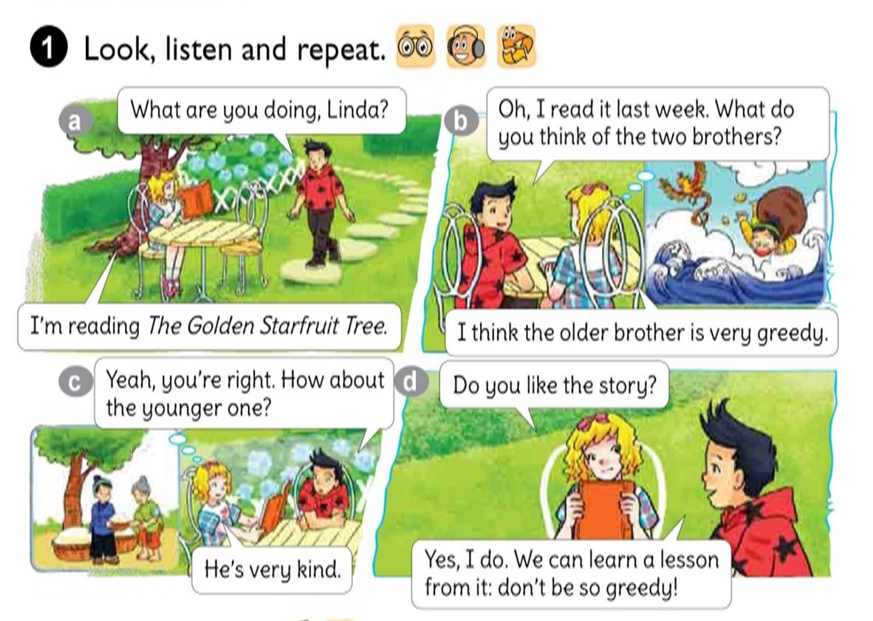

What are you doing , Linda
Oh, I read it last week. What do you think of the two brother?
I’m reading The Golden Starfruit tree.
I think the older brother is very greedy.
Yeah, you’re right. How about the younger one?
Do you like the story?
He’s very kind.
Yes, I do. We can learn a lesson from it: don’t be so greedy!

Slide 6
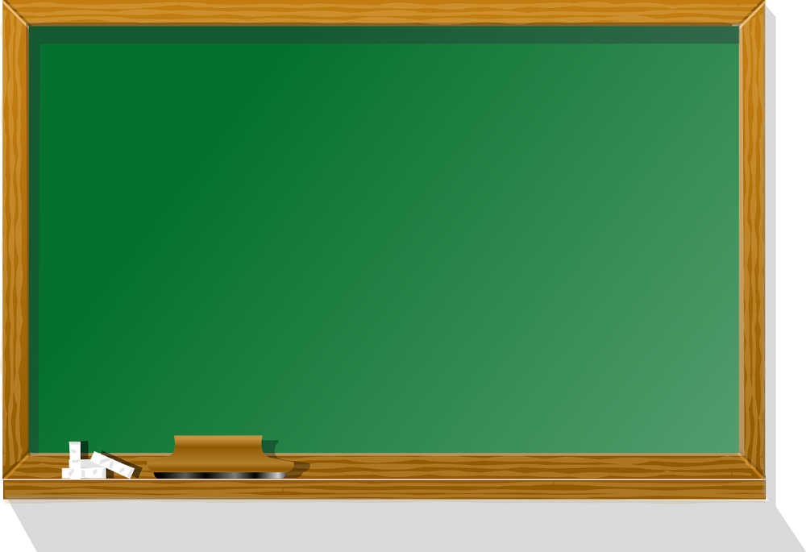

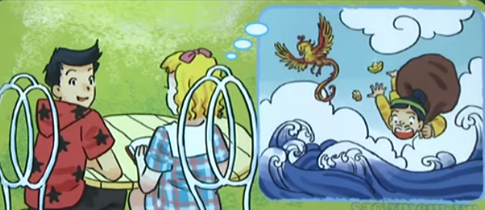

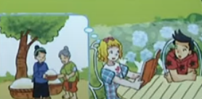
What do you think of the older brother?
I think the older brother is very greedy.
How about the younger one?
He’s very kind.

Slide 7
Tuesday, March 1st, 2022
Unit 14: What happened in the story?
* Structure: Mẫu câu
the older brother
What do you think of _______________?
he is very greedy
I think ______________.

Slide 8



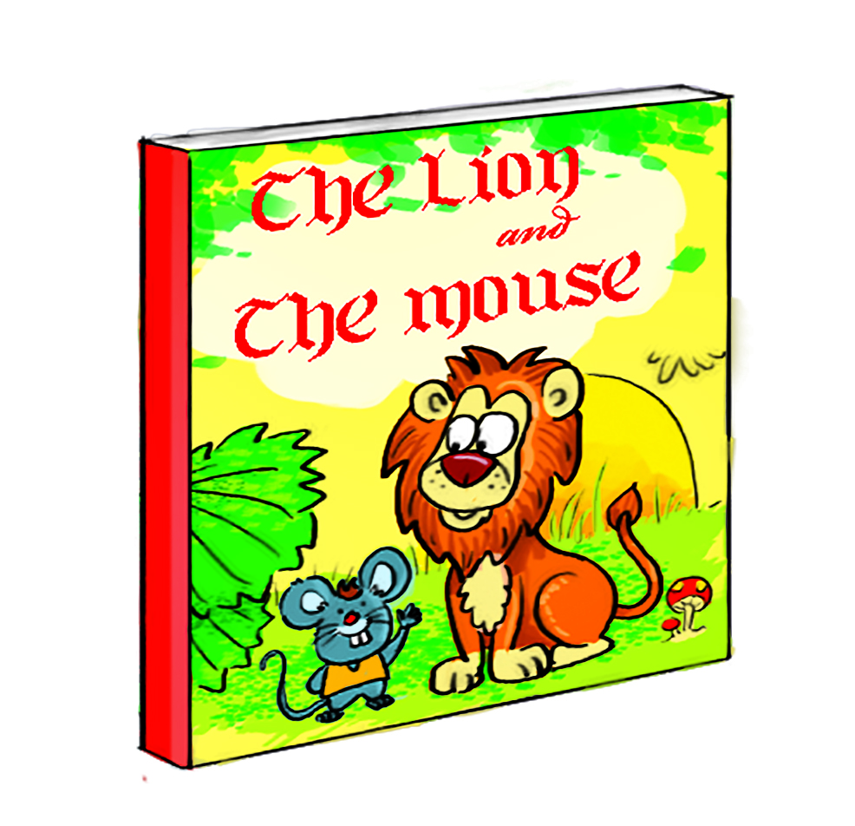

Tuesday, March 1st, 2022
Unit 14: What happened in the story?
the mouse
An Tiem
the older brother
Snow White
intelligent
hard-working
greedy
kind

Slide 9
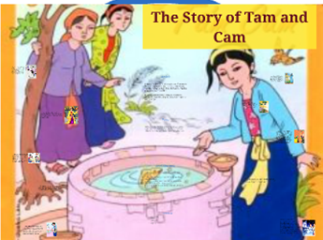


Tuesday, March 1st, 2022
Unit 14: What happened in the story?
3. Let’s talk
Ask and answer questions about a book, a story or a character
What kinds of stories do you like?
I like Tam and Cam.
What do you think of Tam?
I think she’s gentle.

Slide 10
Tuesday, March 1st, 2022
Unit 14: What happened in the story?
3. Let’s talk
Ask and answer questions about a book, a story or a character
What kinds of stories do you like?
I like __________.
What do you think of ________?
I think she’s/ he’s /it’s _________

Slide 11


Slide 12



Thanks for your attention
Good bye
Thanks For Your Attention!

Slide 13

Tuesday, March 1st, 2022
Unit 14: What happened in the story?
Lesson 2 (1,2,3)
* Vovabulary: Từ vựng
The Golden Strarfruit tree: Cây khế vàng
think of…: nghĩ về
greedy: tham lam
intelligent: thông minh
hard-working: chăm chỉ
kind: tốt bụng

Slide 14
Tuesday, March 1st, 2022
Unit 14: What happened in the story?
Lesson 2 (1,2,3)
* Structure: Mẫu câu
What do you think of ………….?
I think……………………….

